Slide 1

The web-based estimation of JOHRH cloaks sales using linear regression method

Slide 2
01
goal
02
Introduction
outline
03
Graphics Analysis
04
result
06

Slide 3

goal
The aim of this study is to apply linear regression methods to forecast the sales of gowns to produce a new line of gowns

Slide 4
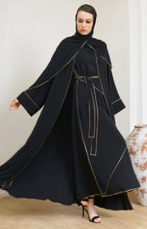
Introduction
The company employs a variety of strategies to increase public interest in the cloaks on offer. The utilization of a range of promotional media is one method that is frequently used.

Slide 5
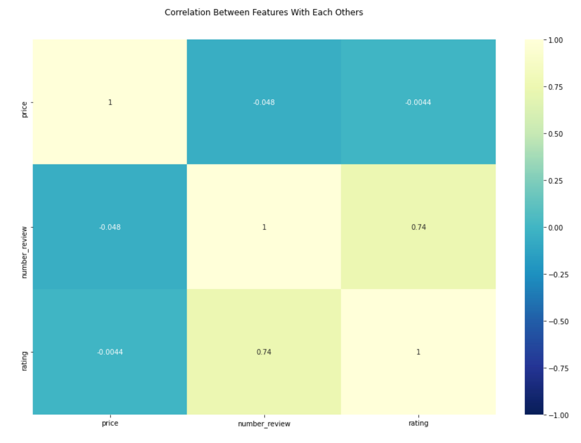


Slide 6
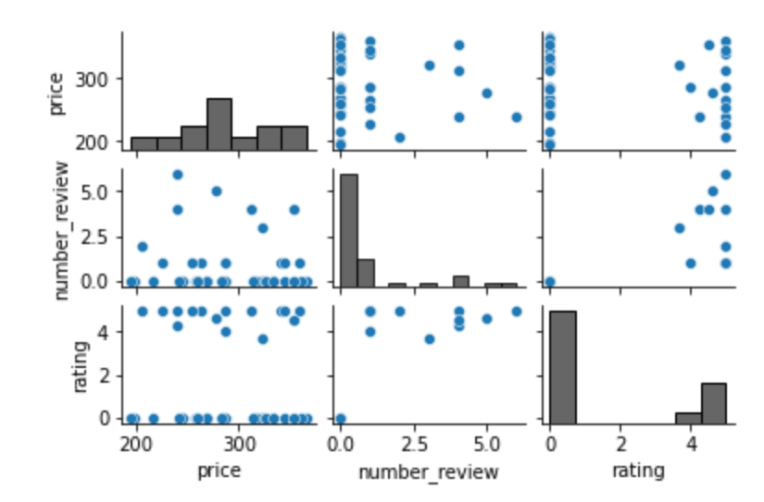
pairplot
The comparison was between the review and the evaluation, but because the review was very little on the site, most of it was zero

Slide 7
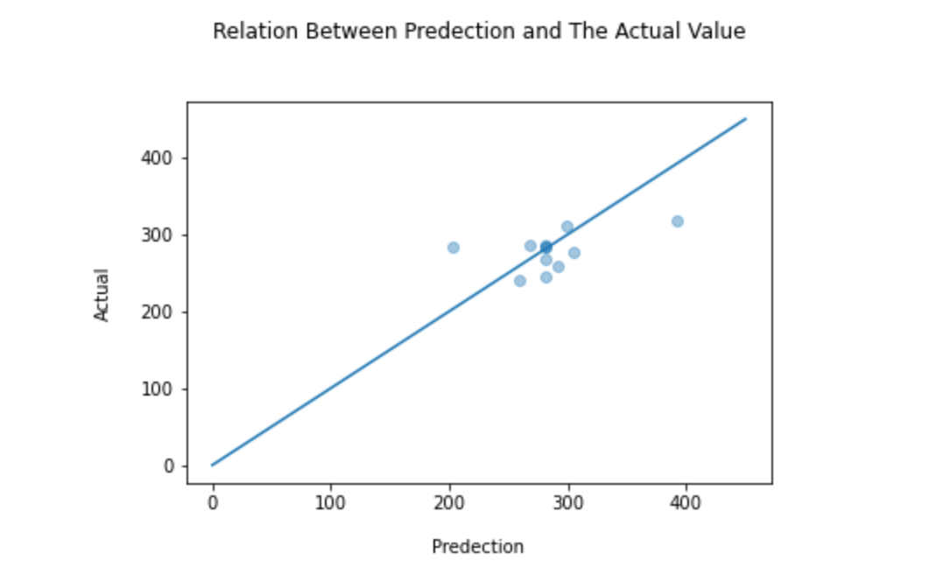
We note that it was not close to the truth

Slide 8
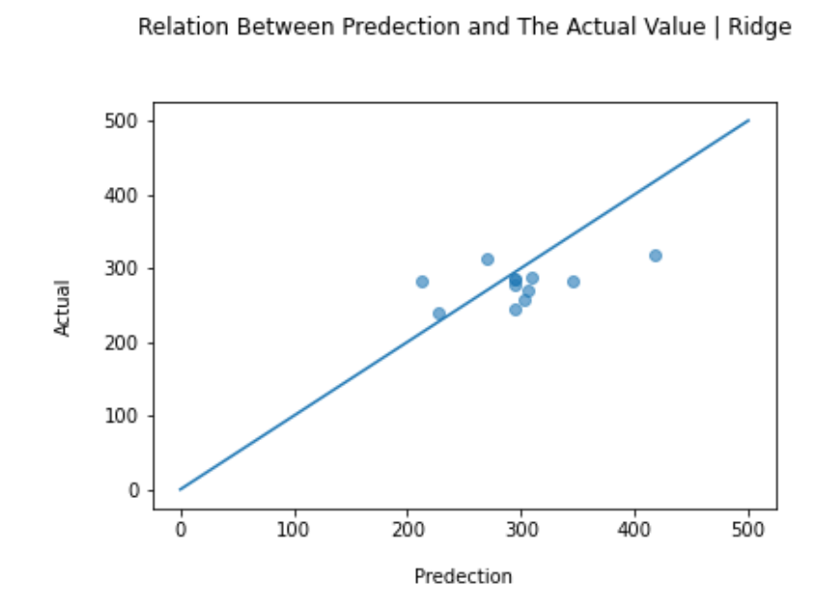
Also here in ridge we note that it was not close to the truth

Slide 9
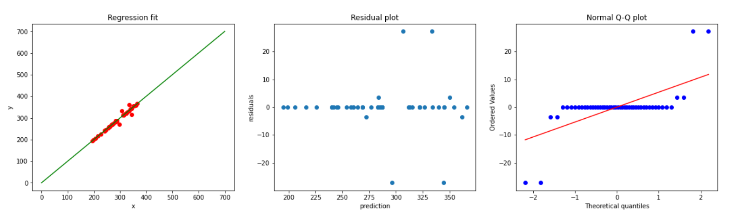

Slide 10





















result
The results indicate that the error rate is rather small and the prediction results are close to accuracy

Slide 11
Thank you

